Slide 1
Génération procédurale
En exemple

Slide 2

Exemple Ghost Recon Wildlands

Slide 3
GhostReconWildlands is the largest action adventure open world ever made at Ubisoft
The game is set in Bolivia
We have a lot of diversity in the game, 11 completely different biomes

Slide 4
Lakes, rivers and streams over a surface of 16km2

Slide 5
It’s mostly a natural environment with many forests
Millions of trees, bushes and rocks
Notes:
Bushes = buissons

Slide 6
Roads : over 600km of roads and even more paths

Slide 7
A full railway network going across the world

Slide 8
Over 200 specific locations in the game: camps, landmarks, outposts and 58 fully procedurally built villages

Slide 9

Base : real terrain
Editing terrain and sculpting tools
Possible to copy/ paste
Possible to erase
By looking at the size of the map led to the conclusion that painting everything manually was a terrible idea.
Need a semi automatic process.
=> Generate the material distribution procedurally

Slide 10
To give a better sense of the relief, the terrain editing tool was already tinting the heightmap depending on the normal direction.
When looking from far away, this simple rule is almost enough to generate a convincing mountain top

Slide 11
Add several conditions based on the topology, noise or simple kernels that could be evaluated in real time in a pixel shader

Slide 13
Notes:
At thistime wewereveryconcernedby anotherchallenge, theroad network !
Generatingitat runtimeseemedlikea technicalnightmareand wewereaffraidto runout of diskspaceif wehadto store iton the bluray.
Wedecidedto carvethe road direcltyintothe terrain insteadof representingitwithtraditionalgeometry.
But thistechnique wouldraiseda few issue likecheap materialtransition and an obviouslackof details.

Slide 14
Notes:
Following this paper :http://arches.liris.cnrs.fr/publications/articles/EG2010_ProceduralGenerationOfRoads.pdf
We started to experiment with weighted anisotropic shortest path algorithm.
Insteadof looking in 4 directions the key was to look in multiple directions and multiple distances for each direction.
It was just what we needed to get to the result we were looking for.

Slide 15
Placing a few way pointson a terrain …

Slide 16
We obtain a consistent network with different types of roads and smallest paths.
Remember that it is all offline processed. Computing time is not (or not really) an issue (about 10minto compute a 2km*2km tile).

Slide 17
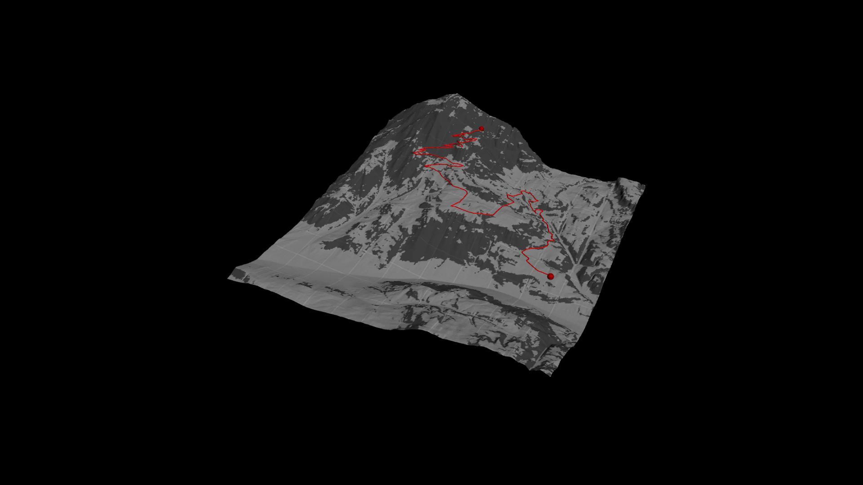
Video of the pathfindingover a tile of terrain and the full extent of road network (without small paths only main roads)

Slide 18
https://vimeo.com/207479400As previously mentioned some tools, like the bridge tool here, can be used in standalone mode to manually create bridges or can be embedded in a bigger tool to automatically create content.
Note: The bridges and tunnels are made of modules. No new or specific geometry is created, its all just instancing.
All the presentation is available here
https://www.gdcvault.com/play/1024029/-Ghost-Recon-Wildlands-Terrain

Slide 19
Procedural generation - Definition
JD Genevaux (Phd Thesis) : La génération procédurale de contenu (Procedural Content Generation ou PCG) est une famille de méthodes où, au lieu de stocker des objets 3D, on stocke les paramètres d’un algorithme de construction. Ces méthodes ont été très utilisées dans les années 70-80, à l’époque où les ordinateurs avaient peu de mémoire. Pour créer des univers très étendus, on s’appuyaient généralement sur ces méthodes qui utilisent beaucoup la notion d’aléatoire.

Slide 20
Procedural Modeling
L-Systems
Procedural Terrain
Procedural Behavior
Based on the slides from 15-462 Spring 2007
http://graphics.cs.cmu.edu/nsp/course/15-462/Fall07/462/lectures/nov20a.ppt

Slide 21
Database Amplification
Procedural content generation is attractive because it allows for significant database amplification
Limited input data produces rich & varied output
ie: Perlin noise function + basic math gives fire, clouds, wood, etc.
If it can be generated on the fly…
Artist doesn’t have to design it
Don’t need to store/transmit it

Slide 22
L-Systems
Developed by Aristid Lindenmayer to model the development of plants
Based on parallel string-rewriting rules
Excellent for modelling organic objects and fractals

Slide 23
L-Systems Grammar
Begin with a set of “productions” (replacement rules) and a “seed” axiom
In parallel, all matching productions are replaced with their right-hand sides
Ex:
Rules:
B -> ACA
A -> B
Axiom: AA
Sequence: AA, BB, ACAACA, BCBBCB, etc.
Strings are converted to graphic representations via interpretation as turtle graphics commands

Slide 24
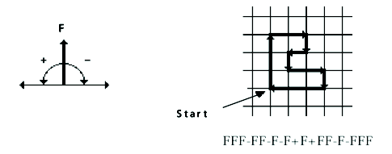
Turtle Commands
F_{x}: move forward one step, drawing a line
f_{x}: move forward one step, without drawing a line
+_{x}: turn left by angle ∂
-_{x}: turn right by angle ∂

Slide 25
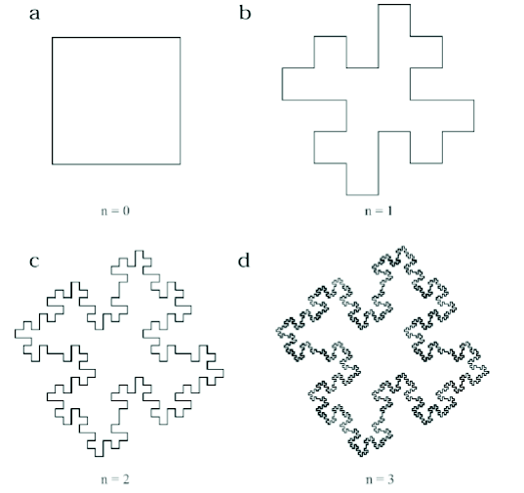
L-Systems Example: Koch Snowflake
Axiom: F-F-F-F ∂ :90 degrees
F -> F-F+F+FF-F-F+F

Slide 26
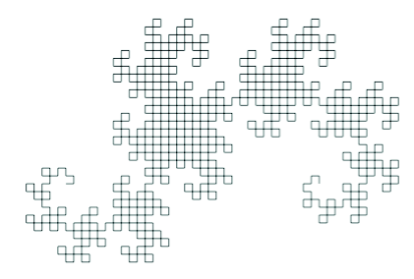
L-Systems Example: Dragon Curve
Axiom:F_{l} ∂ :90 degrees n:10 iterations
F_{l} -> F_{l}+F_{r}+
F_{r} -> F_{l}-F_{r}-

Slide 27
Example : Koch Snowflakes
N=1
n=0 : f -- f -- f
n=1 : f + f -- f + f -- f + f -- f + f -- f + f -- f + f
n=2 : f + f -- f + f + f + f + f -- f + f -- f + f -- f + f + f
+ f -- f + f -- f + f -- f + f + f + f + f -- f + f -- f + f -- f
+ f + f + f -- f + f -- f + f -- f + f + f + f + f -- f + f -- f
+ f -- f + f + f + f -- f + f
Assign meaning to each component of the alphabet
f draw forwards
+ turn 60 degrees right
- turn 60 degrees left
N=2
N=3
N=4

Slide 28
L-Systems Grammar: Extensions
Basic L-Systems have inspired a large number of variations
Context sensitive: productions look at neighboring symbols
Bracketed: save/restore state (for branches)
Stochastic: choose one of n matching productions randomly
Parametric: variables can be passed between productions

Slide 29
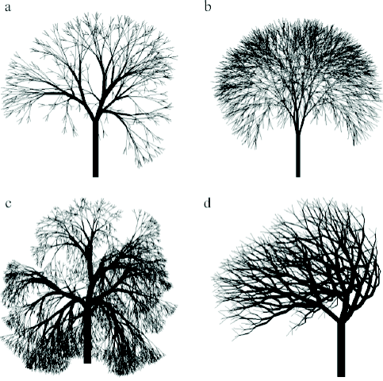

L-Systems for Plants
L-Systems can capture a large array of plant species
Designing rules for a specific species can be challenging

Slide 30
L-Systems: Further Readings
Algorithmic Botany
Covers many variants of L-Systems, formal derivations, and exhaustive coverage of different plant types.
http://algorithmicbotany.org/papers
PovTree
http://arbaro.sourceforge.net/

Slide 31
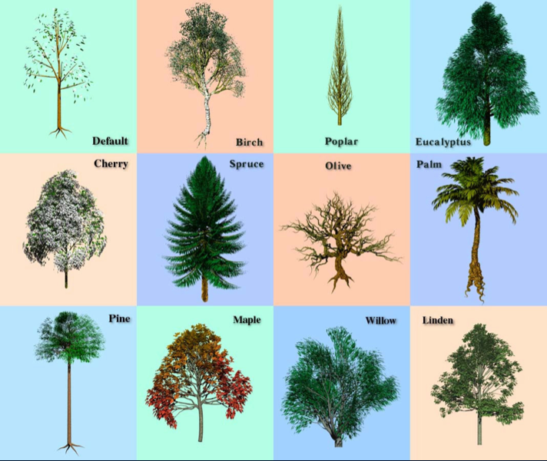
PovTree

Slide 32
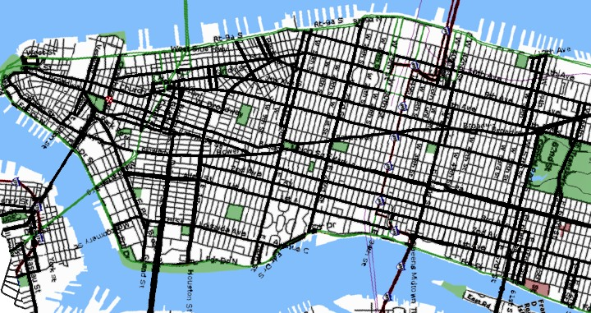
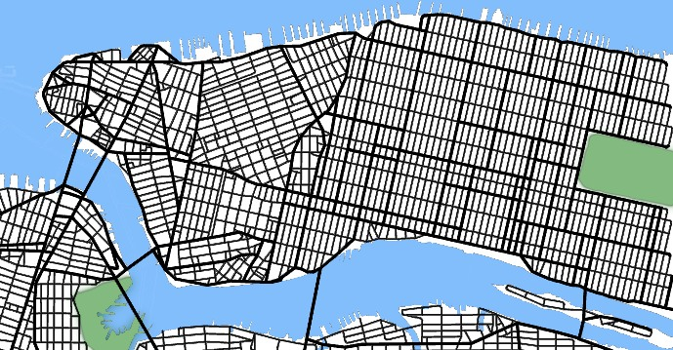
L-Systems for Cities [Parish01]
Start with a single street
Branch & extend w/ parametric L-System
Parameters of the string are tweaked by goals/constraints
Goals control street direction, spacing
Contraints allow for parks, bridges, road loops
Once we have streets, we can form buildings with another L-System
Building shapes are represented as CSG operations on simple shapes

Slide 33
Procedural Terrain: Perlin Noise
Noise Functions
Seeded pseudo-random number generator
Over R^{n}
Approximation to gaussian filtered noise
Implemented as a pseudo-random spline
The trick is to make it fast

Slide 34
Noise Functions: Algorithm
Given an input point
For each of its neighboring grid points:
Pick a "pseudo-random" gradient vector
Precompute table of permutations P[n]
Precompute table of gradients G[n]
G = G[ i + P[ j + P[ k ] ] ]
Compute linear function (dot product)
Take weighted sum, using ease curves
http://www.noisemachine.com/talk1/java/noisegrid.html

Slide 35
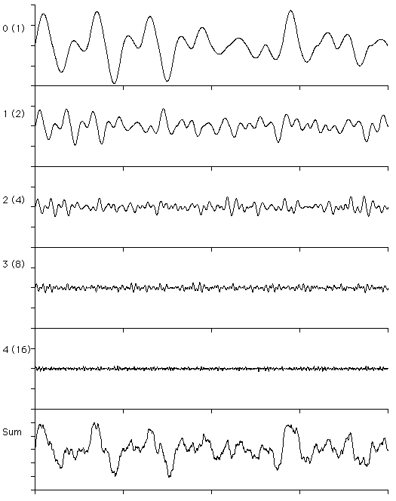
Perlin Noises in 1-D

Slide 36
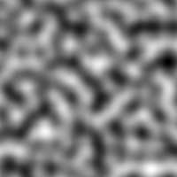
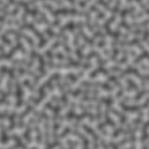



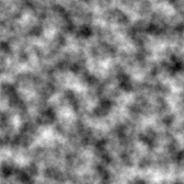
Perlin Noises in 2-D

Slide 37
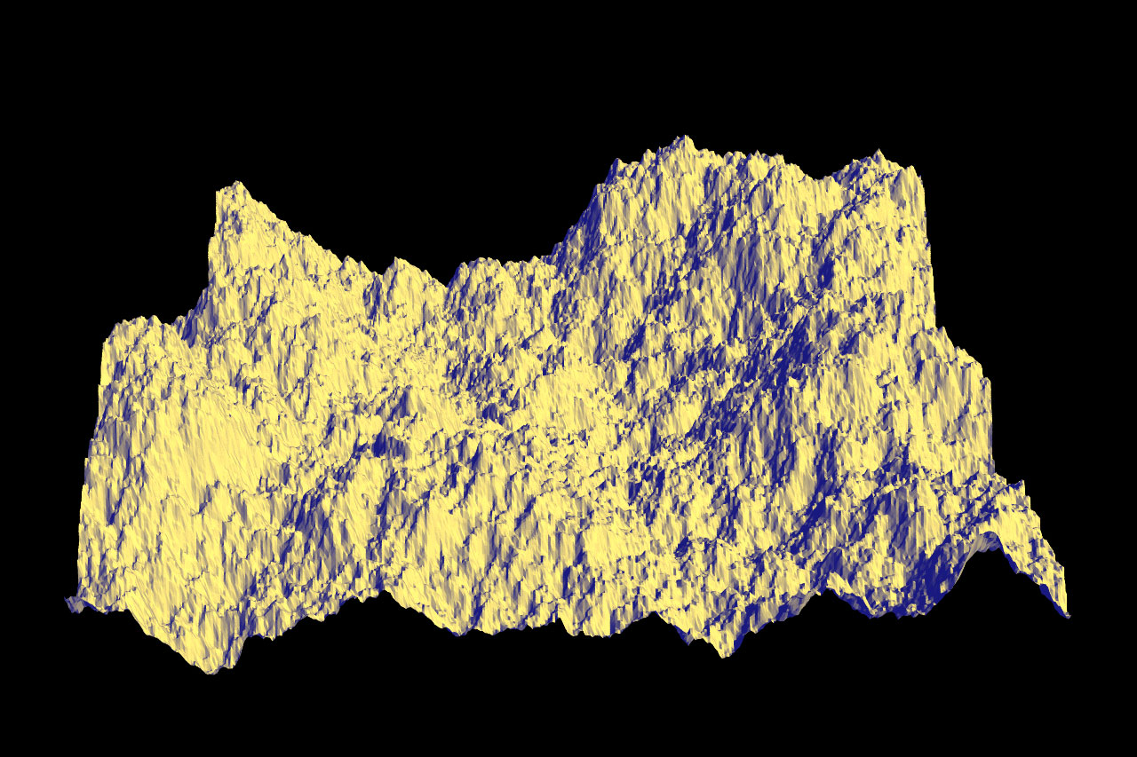
Fractal Noise Terrain
Use fractal noise to generate terrain
Can be made tileable over unit square:
F_{tileable}(x,y) = [
F(x,y) * (1-x) * (1-y) +
F(x-1,y) * x * (1-y) +
F(x-1,y-1) * x * y +
F(x,y-1) * (1-x) * y]
F.K. Musgrave

Slide 38
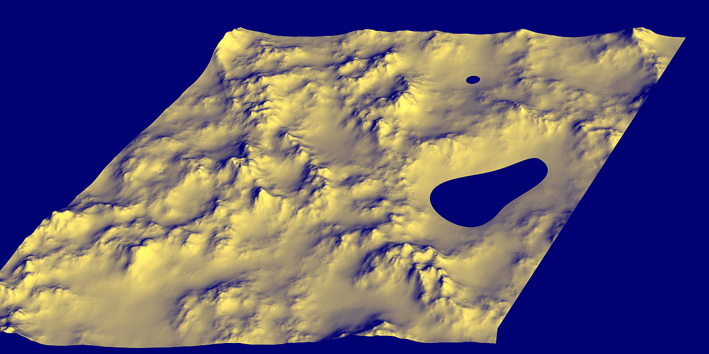
Adding Water
Use an elevation threshold (z < z_{water})
F.K. Musgrave

Slide 39
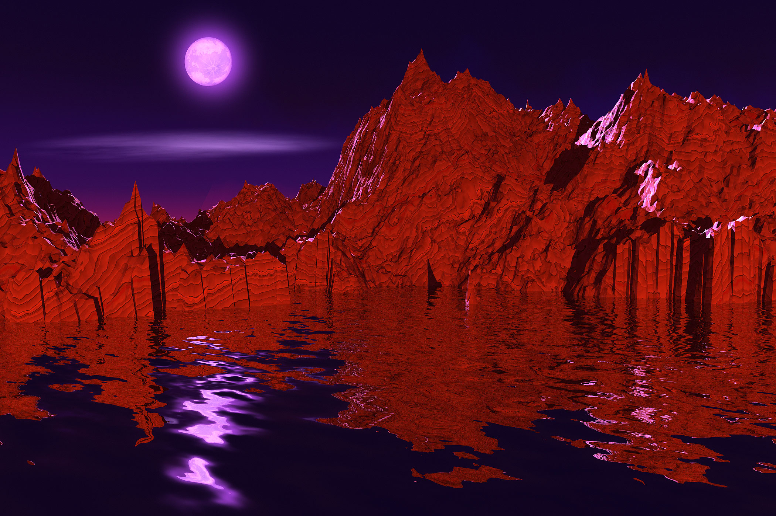
Terrain Example
F.K. Musgrave

Slide 40

Terrain Example
F.K. Musgrave

Slide 41
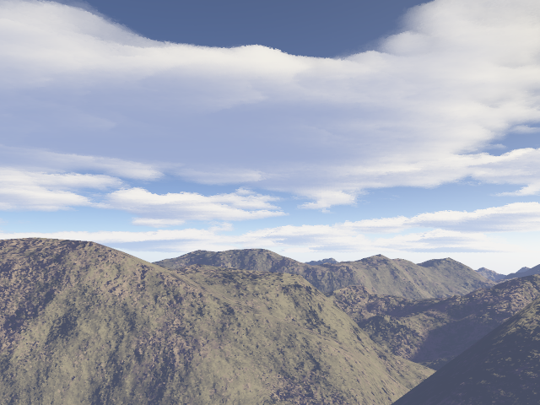
Terragen
Commercial product (free for personal use)
Website: http://www.planetside.co.uk/terragen/

Slide 42
Procedural Animation
Fluid simulation
Particle Systems
Flocking/crowd simulations

Slide 43
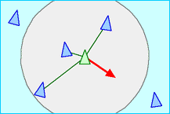
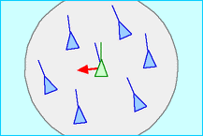
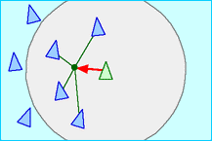
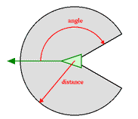
Procedural Flocking (Boids)
Simulate the movement of a flock of birds in 3-space
Separation: move to avoid crowding local neighbors
Alignment: steer towards average heading of neighbors
Cohesion: steer towards average position of neighbors
Limited Senses: only neighbors in forward-facing arc are observable

Slide 44
Boids Sample
http://www.red3d.com/cwr/boids/
http://www.siggraph.org/education/materials/HyperGraph/animation/art_life/video/3cr.mov

Slide 45
Projet Script
Projet en binômes complémentaires. Vous pouvez garder le même binôme que pendant les TD.
Dans ce projet, vous devrez modéliser automatiquement un terrain, des routes, des maisons et de la végétation. Vous pouvez vous intéresser à la densité de la ville en passant en mode semi-urbain ou urbain, voire si vous le souhaitez, vous intéresser à une représentation plus rurale.
Cette génération doit être réglable ; une interface peut être définie dans ce sens (voir Tutotial de max sur les interfaces : http://download.autodesk.com/us/maya/Maya_2014_GettingStarted/index.html)
De nombreux scripts de création de terrains, de végétation et routes existent sur Internet. Par exemple :
https://www.youtube.com/watch?v=tH41i_sLgo8&index=2&list=PL8hZ6hQCGHMUW66ALR0p1E4IMiFS64hBd
https://www.youtube.com/watch?v=tH41i_sLgo8&index=2&list=PL8hZ6hQCGHMUW66ALR0p1E4IMiFS64hBd
https://www.youtube.com/watch?v=x4zraXmALlo
https://www.youtube.com/watch?v=8zlKofCqWp8
http://lesterbanks.com/2010/02/a-few-building-city-generation-tools-for-maya/

Slide 46
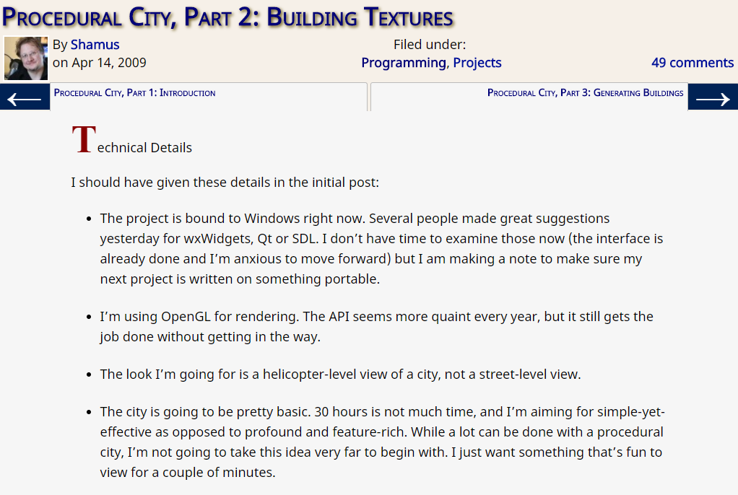
Projet Script
http://www.shamusyoung.com/twentysidedtale/?p=2954
La vidéo : https://youtu.be/-d2-PtK4F6Y

